Slide 1
XYZ marketing campaign Anna Mizera

Slide 2
SUMMARY
The aim of this task is to select the clients who will positively respond to marketing campaign by building the uplift model.
Based on the dataset („Pilot”) that includes the results of A/B testing campaign, I trained and tested models using two model approach with several auxiliary models and direct uplift method.
I examined the results of the analysis of the tested models and selected the Uplift Random Forest
Finally, I applied the model on the new dataset („Customer Base”) and produced the recommendation of the customers that should be targeted in the campaign.
Potential model improvements:
Apply The Class Transformation Method to the data and verify if it would improve the results
Perform Grid search to optimize the current approach.

Slide 3
XYZ ’S CASE STUDY
CASE INTRODUCTION
XYZ is a major telecommunications operator in Central Europe.
As a part of marketing workstream, I worked with advanced analytics team in order to improve XYZ’s marketing campaign effectiveness.
My goal was to maximize profit from the marketing campaign, by selecting clients who are the most likely to positively react to the campaign.

Slide 4
XYZ’ S CASE STUDY
PROCESS OF PROBLEM SOLVING
The team has tested a number of propensity models (e.g., logistic regression and classification trees) to identify customers most likely to buy the new service
In order to further improve on those models, the team performed a randomized pilot also known as A/B testing of this marketing campaign.
Based on A/B testing results I run uplift model to help to decide whether the client should be targeted in marketing campaign.

Slide 5
UPLIFT MODELLING
INTRODUCTION TO UPLIFT MODELLING
„Marketing campaigns directed to randomly selected customers often generate huge costs and a weak response. Moreover, such campaigns tend to unnecessarily annoy customers and make them less likely to answer to future communications. Precise targeting of marketing actions can potentially results in a greater return on investment. Usually, response models are used to select good targets. They aim at achieving high prediction accuracy for the probability of purchase based on a sample of customers, to whom a pilot campaign has been sent. However, to separate the impact of the action from other stimuli and spontaneous purchases we should model not the response probabilities themselves, but instead, the change in those probabilities caused by the action. The problem of predicting this change is known as uplift modeling, differential response analysis, or true lift modeling.”
„To build an uplift model, a random sample (the treatment dataset) of customers is selected and subjected to the marketing action. Disjoint sample is also selected (the control dataset), to which the action is not applied, and which serves as the background against which the results of the action will be measured. The model is now built for predicting the difference between class probabilities on the two sets of data. „

Slide 6
UPLIFT MODELLING
FIRST METHOD - TWO MODEL APPROACH
The aim is to build two separate „classic” machine learning models, one on the treatment and one on control dataset. For both groups I build separate models on training data. Then, I estimated predictions based on both models in control and treatment groups. Finally, I calculated the difference between them.
That gives us the estimation of uplift (average customers’ reaction to the treatment).
Control sample
Treatment sample
Model on control sample
Marketing campaign
UPLIFT
Model on treatment sample
P (buy | campaign) - P (buy | no campaign)

Slide 7
UPLIFT MODELLING
SECOND METHOD – DIRECT APPROACH
The goal is to model the difference between treatment and control probabilities directly by modifying the „classical” machine learning model such as: logistic regression, K-nearest neighbours and SVM. The most widely known are uplifting methods build on decision tree and random forest.
Uplift Decision Tree
Single decision tree is built by using uplift criterion (Kullback-Leibler (KL), Euclidean distance, Chi) that evaluate the best split. At each split, the goal is to maximize the difference between treatment and control probabilities in the the right and left subtree.
Uplift Random Forest
It works similarly to „classic” random tree method although it creates collections of trees based on Uplift Decision Tree Method (Each time select at random data points by sampling from training set. At each split, select random subset of features. Finally, build a tree using chosen splitting criterion.).

Slide 8
DATABASE DESCRIPTION
Database „Pilot” provides 20 explanatory variables (including two categorical variables and one dummy variable) as well as treatment and response columns. It was applied to train and test the uplifting models.
Database „Customer base” contains explanatory variables. It has been used to produce final predictions of the selected model.
Steps taken in data preprocessing:
- Searching for missing data.
- Outlier analysis was not performed due to anonimity of variables.
- Encoding categorical data.
- Spliting data on training set and test set.
- Feature scaling of explanatory variables.
- Visualising explanatory variables. (appendix)
DATA

Slide 9
TESTED MODELS
LIST OF THE TESTED MODELS
The key aim of this exercise is to develop statistical uplift models and choose the most appropriate one. I have used two modeling approaches.
First, I have applied T- learner with auxiliary classical models such as:
XGBoost
Logistic Regression
K - Neareast Neighbours
- Decision Tree
- Random Forest.
The second approach is direct uplift modeling. I have chosen two methods:
decision tree and uplift random forrest.

Slide 10
TESTED MODELS
INITIAL ANALYSIS FOR TESTED MODEL ON RANDOM DATASET
Initially. I split „pilot” dataset into random train and test subsets.
In case of each method, I performed the following procedure:
I fitted the model on chosen training set and make predictions on test set.
I calculated auuc score, gini score and plotted gini curve and lift curve
Additionally I built functions plotting sorted uplifts (plot_my_uplift) and gini curve
(plot_my_qini).
Moreover,I wrote function that returns a number of customers who should be targeted (given high estimated uplift) and a numer accounting for call center capacity restriction (to_target). In order to determine whether a particular customer should be targeted, the following rule has been applied:
100 * estimated uplift – 5 > 0
where estimated uplift is an estimated average treatment effect (model output) based on specific client features (X).
5. Finally the list of the customers to be targeted is produced. (who_to_call)
.

Slide 11
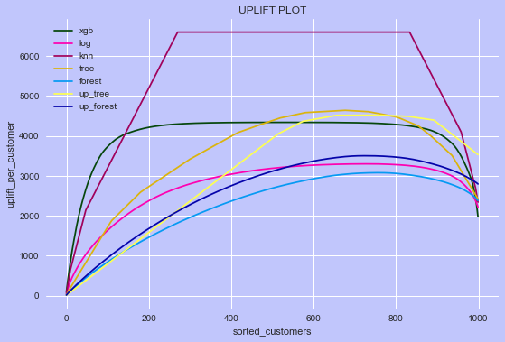
TESTED MODELS
The plot displays scaled qini curves based on initial analysis of all tested models. Qini curves were developed by first sorting customers by uplift score and then calculating cumulative sums. Additionally, uplifts were multiplied by 100 units to show the average profit gain from reaction on treatment. Selecting the model by comparing the curves calculated only for one random data set can be misleading. KNN model produces the highest curve. However, the following slides indicate that auuc score and qini score are the lowest among all tested methods.

Slide 12
CROSS VALIDATION
EVALUATION OF UPLIFT MODELS
On particular data set, one specific method may be the best fit. However, when training on similar but different data set, its performance may worsen.
In order to obtain robust measure of model performance, I tested uplift models on several randomly selected data sets.
For every method, I randomly split pilot dataset into training and testing set with 20 different seeds. Then for every data set:
I trained the model;
Calculated the predictions on test sets;
Calculated gini score and auuc score.
Finally, I calculated mean of both measures to conclude which of the models performs best on average. The results are illustrated in the following slides.

Slide 13
CROSS VALIDATION
QINI SCORE
Random State | T – Learner XGBoost | T – Learner Logistic | T – Learner Knn | T – Learner Decision trees | T – Learner Random forest | Uplift Decision trees | Uplift Random forest
0 | -0,259 | -0,931 | 0,042 | 2,455 | 1,148 | 0,87 | 1,708
1 | 0,056 | 0,6 | -0,265 | 0,163 | 0,174 | 0,45 | 0,415
2 | -0,198 | 0,206 | 0,091 | -0,137 | 0,034 | 0,17 | 0,116
3 | 0,132 | 0,115 | 0,531 | 0,335 | 0,504 | -0,015 | 0,342
4 | 0,409 | 0,245 | -0,337 | 0,354 | 0,397 | 0,224 | 0,51
5 | 0,165 | 0,566 | -0,178 | 0,171 | 0,428 | 0,015 | 0,362
6 | 0,68 | 0,737 | 0,23 | 0,735 | 0,758 | 0,709 | 0,596
7 | 1,572 | 0,679 | -0,364 | 1,37 | 1,226 | 0,917 | 1,353
8 | 0,802 | 0,74 | -1,088 | 0,405 | -0,03 | 0,79 | 0,16
9 | 0,328 | 0,374 | -0,251 | 0,4 | 0,96 | 0,462 | 0,879
10 | -0,296 | 0,495 | -0,749 | -0,199 | 0,152 | 0,142 | 0,145
11 | 0,101 | 0,017 | 0,036 | 0,273 | 0,29 | -0,072 | 0,218
12 | 0,248 | 0,321 | -0,017 | 0,25 | 0,441 | 0,053 | 0,389
13 | -0,675 | -1,258 | -1,526 | 0 | 2,008 | 1,085 | 2,513
14 | 0,342 | 3,709 | 0,04 | 0,701 | 2,848 | -0,184 | 3,203
15 | 1,097 | 2,883 | 0,132 | 3,08 | 3,326 | 0,435 | 2,655
16 | -0,373 | 0,216 | -0,731 | 0,265 | 0,194 | 0,049 | 0,339
17 | 0,97 | 0,51 | 0,928 | 1,078 | 1,462 | 0,116 | 1,049
18 | -0,086 | 0,377 | -0,17 | 0,046 | 0,141 | 0,09 | 0,205
19 | 0,824 | 1,159 | 0,446 | 1,062 | 0,99 | 0,278 | 0,982
MEAN | 0,292 | 0,588 | -0,16 | 0,64 | 0,873 | 0,329 | 0,907
QINI
The difference between
the area under the Uplift Curve and the random curve
Above results indicate that Uplift Random Forest and T- Learner Random Forest, on average, produce the highest qini score, around 0,9. Logistic Regression and Decision tree can be characterised by lower qini score of approx. 0.6. In contrast, KNN method yields negative score.

Slide 14
CROSS VALIDATION
AUUC SCORE
Random State | T – Learner XGBoost | T – Learner Logistic | T – Learner Knn | T – Learner Decision trees | T – Learner Random forest | Uplift Decision trees | Uplift Random forest
0 | -0,008 | -0,618 | 0,347 | 2,817 | 1,478 | 1,221 | 1,856
1 | 0,514 | 1,008 | 0,134 | 0,536 | 0,581 | 0,848 | 0,680
2 | 0,262 | 0,659 | 0,543 | 0,296 | 0,475 | 0,638 | 0,540
3 | 0,679 | 0,752 | 1,131 | 0,822 | 1,078 | 0,535 | 0,937
4 | 0,902 | 0,775 | 0,144 | 0,864 | 0,865 | 0,746 | 0,913
5 | 0,607 | 1,008 | 0,288 | 0,596 | 0,828 | 0,461 | 0,735
6 | 1,109 | 1,168 | 0,665 | 1,126 | 1,156 | 0,988 | 1,042
7 | 1,972 | 1,094 | 0,061 | 1,652 | 1,609 | 1,216 | 1,828
8 | 1,571 | 1,571 | -0,322 | 1,229 | 0,720 | 1,753 | 0,854
9 | -0,213 | -0,169 | -0,808 | -0,136 | 0,358 | -0,048 | 0,354
10 | 0,322 | 1,220 | -0,139 | 0,447 | 0,807 | 0,802 | 0,769
11 | 0,637 | 0,562 | 0,592 | 0,781 | 0,844 | 0,466 | 0,788
12 | 0,685 | 0,760 | 0,455 | 0,693 | 0,924 | 0,508 | 0,846
13 | -0,641 | -1,191 | -1,408 | 0,027 | 2,171 | 1,199 | 1,787
14 | 0,909 | 4,231 | 0,683 | 1,279 | 3,285 | 0,437 | 3,341
15 | 1,452 | 3,295 | 0,482 | 3,566 | 3,248 | 0,763 | 2,789
16 | 0,217 | 0,871 | -0,178 | 0,850 | 0,797 | 0,595 | 0,894
17 | 1,186 | 0,749 | 1,158 | 1,330 | 1,819 | 0,321 | 1,326
18 | 0,366 | 0,852 | 0,289 | 0,504 | 0,559 | 0,558 | 0,624
19 | 1,581 | 1,784 | 1,121 | 1,705 | 1,633 | 0,889 | 1,510
MEAN | 0,706 | 1,019 | 0,262 | 1,049 | 1,262 | 0,745 | 1,221
AUUC
Area Under
the Uplift Curve
T_learner Random Forest and Uplift Random Forest yields the highest results of AUUC score, around 1,2.
Decision Tree and Logistic Regression have moderate score of approx. 1. KNN method provides inferior score equal 0.2.

Slide 15
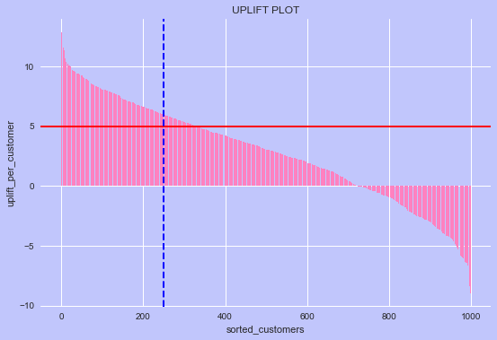
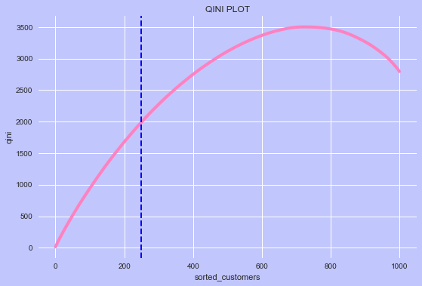
SELECTED MODEL - OUTPUT
MODEL OUTPUT – PILOT
Of all methods that I examined, I selected direct uplift Random Forest. According to the cross validation results, it produces the highest average auuc score and qini score, based training the model on 20 random datasets.
The selected model (decision rule) indicates the following:
A treatment is estimated to have a positive impact on 328 people, higher than marginal cost of a call. Therefore, it is advised to target 250.0 customers, due to the constraint imposed in the exercise.

Slide 16
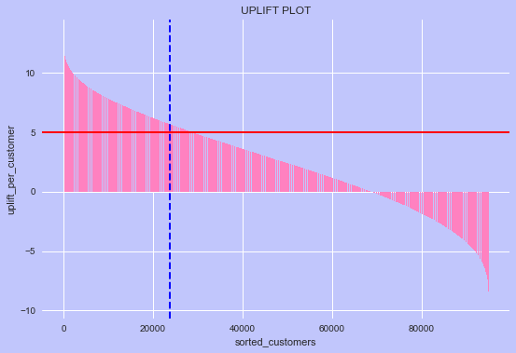
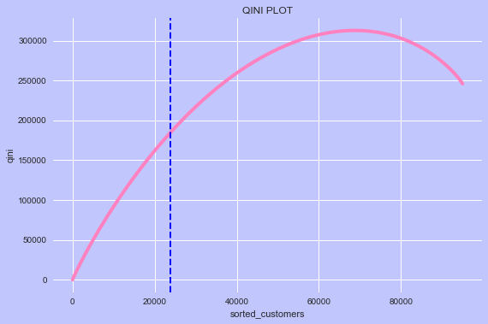
SELECTED MODEL - OUTPUT
MODEL OUTPUT – CUSTOMER BASE
The selected model (decision rule) indicates the following:
A treatment is estimated to have a positive impact on 25907 people from customer base, higher than marginal cost of a call. Therefore, it is advised to target 23750 customers, due to the constraint imposed in the exercise.

Slide 17
gutierrez17a.pdf (mlr.press)
LITERATURE
Welcome to Causal ML’s documentation — causalml documentation
73112-Rzepakowski.dvi (itl.waw.pl)
(4) Why R? + McKinsey Webinar - M. Zawisza + A. Reinert - Uplift modeling for marketing campaigns - YouTube
(PDF) Decision Trees for Uplift Modeling (researchgate.net)

Slide 18
APPENDIX

Slide 19
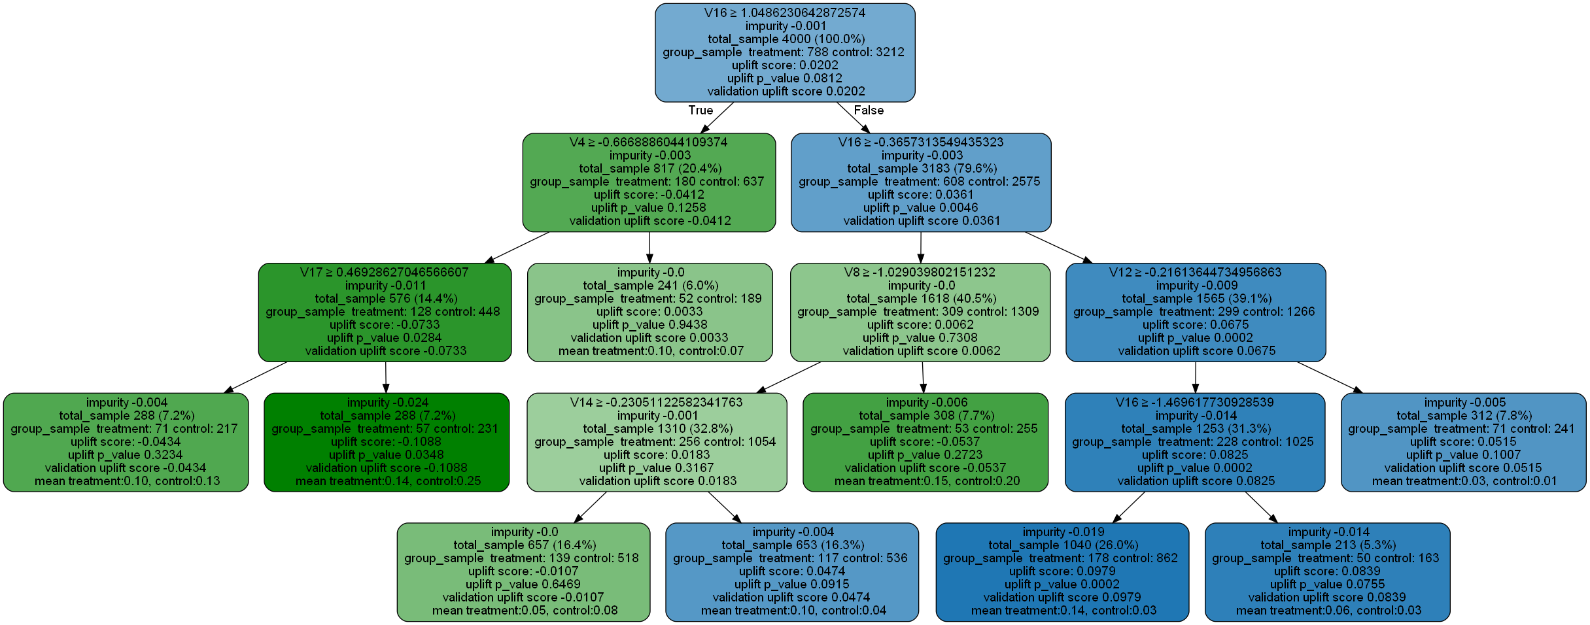
The graph presents the example of uplift decision tree.

Slide 20
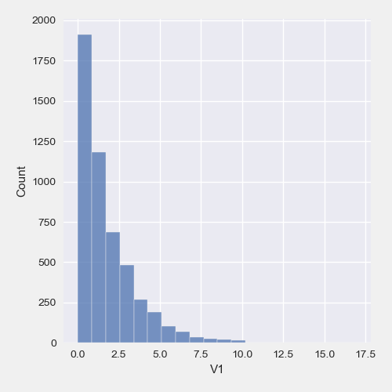
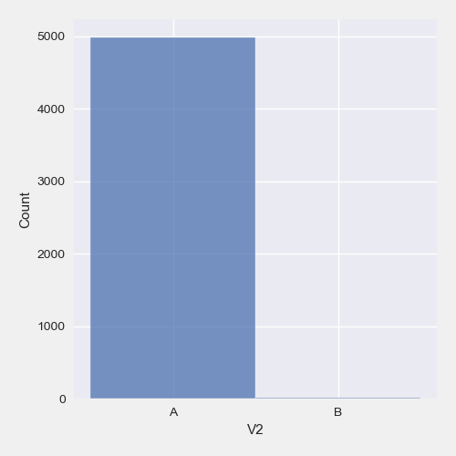
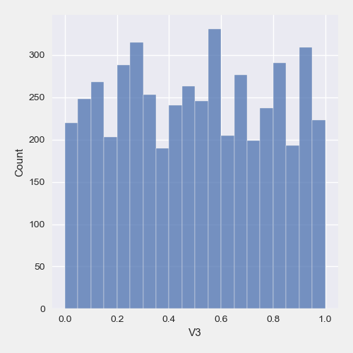
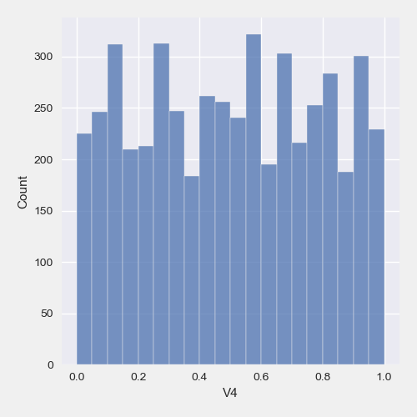
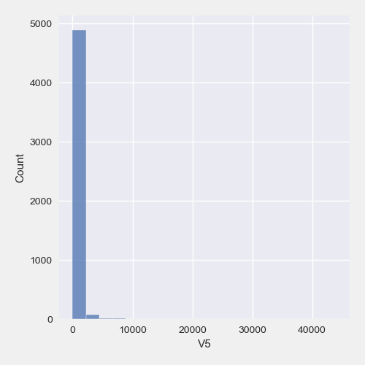

DATA HISTOGRAMS PILOT

Slide 21
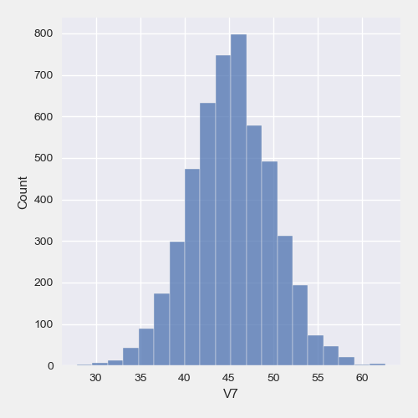
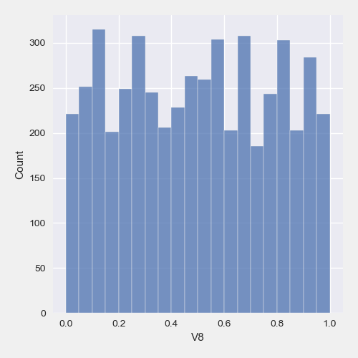
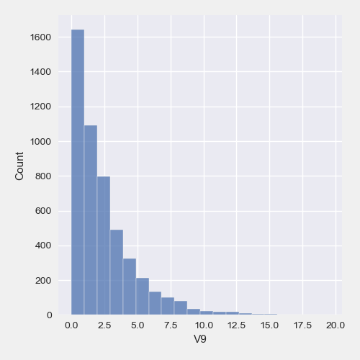
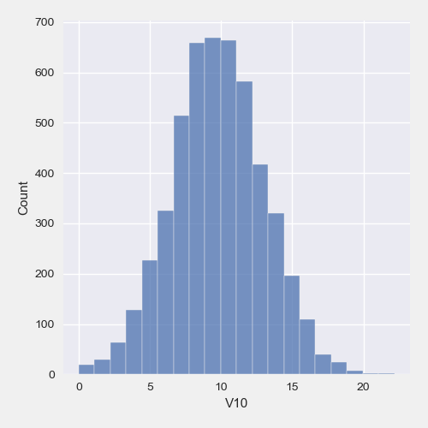
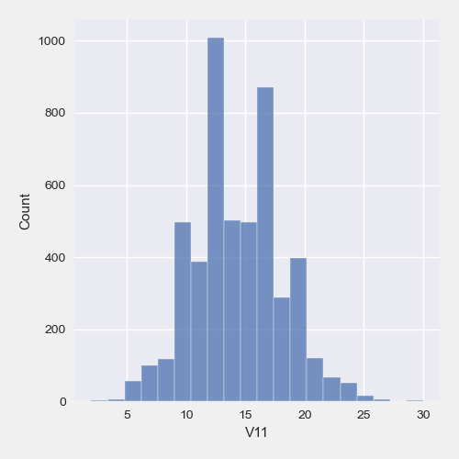

DATA HISTOGRAMS PILOT

Slide 22
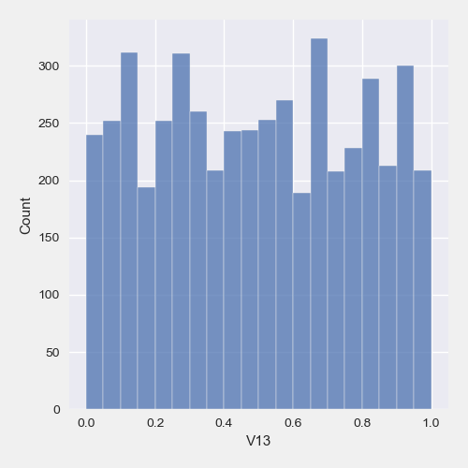
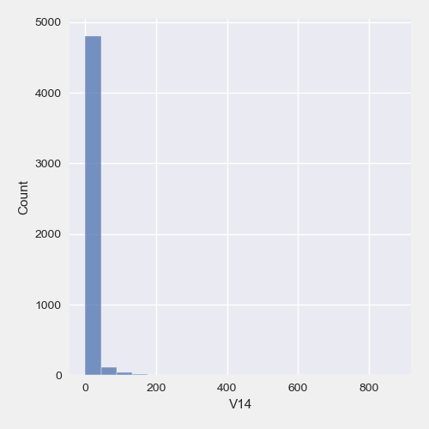
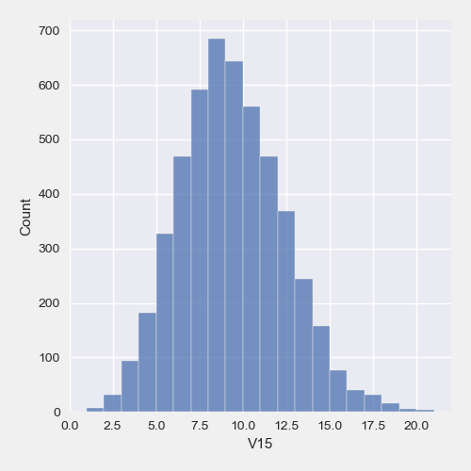
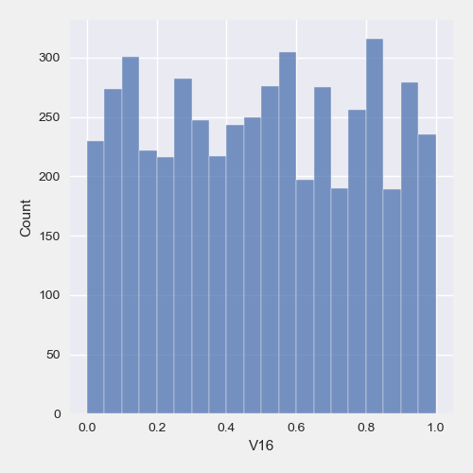

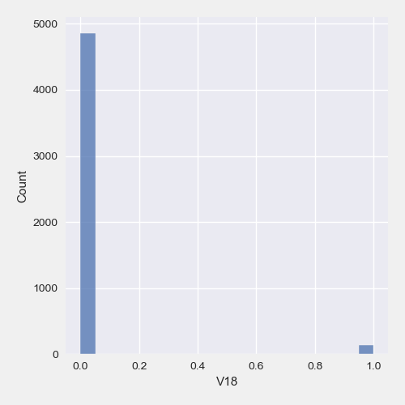
DATA HISTOGRAMS PILOT

Slide 23
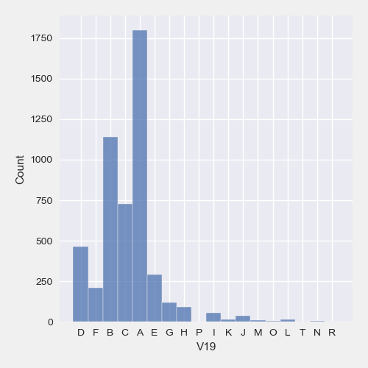
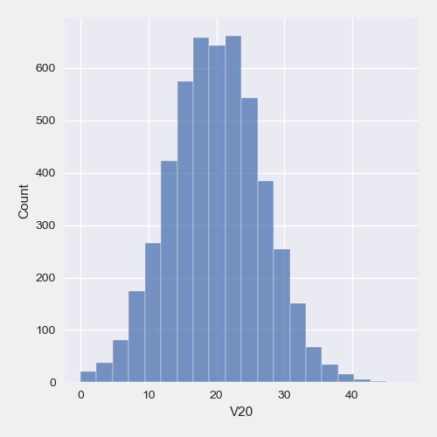
DATA HISTOGRAMS PILOT

